Slide 1




Car Accidents Analysis

Slide 2






Our Team
Arwa Nabil
Mohamed Ibrahim
Kareem Farahat
Mahmoud Ahmed
Omar Mohammed
Muhammed Megahed

Slide 3


Agenda
Problem Statement
01
Objectives
02
DataSet Overview
03
Data Cleaning
04
Data Modeling
05
Dax
06
Sample Visuals
07
Reports & Dashboards
08
Key Findings
09
Recommendation
10

Slide 4

01 Problem Statement
According to the Central Agency for Public Mobilization and Statistics (CAPMAS) in Egypt, road accident fatalities reached 5,260, while road traffic injuries increased from 71,016 in 2023 to 76,362 in 2024 (an increase of 7.5%).
In this project, we analyze car accident data from the United States as a model to uncover the main causes of accidents and explore ways to reduce them.

Slide 5

02 Project Objectives
The aim of this dashboard is to identify the main reasons behind car accidents, and to analyze how, when, and under what conditions they most frequently occur.
Question 01
Question 02
Question 03
How has car accident data changed over the past few years?
Which factors, such as traffic, weather, lighting, and road conditions, contribute most to accidents?
How can this methodology be applied to Egyptian data to better understand local accidents?

Slide 6
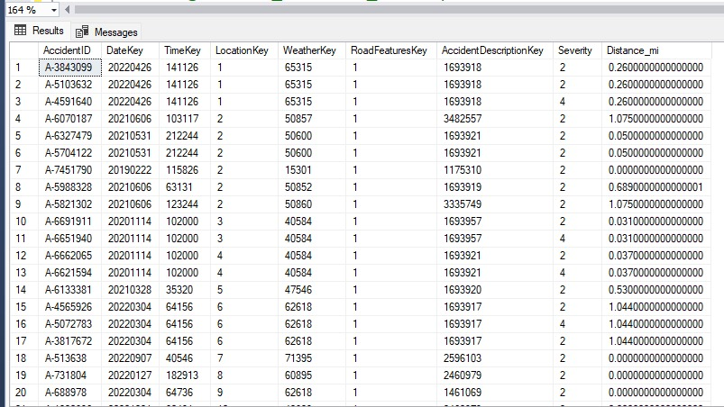
03 Dataset Overview
US Car Accidents (CSV)
From Kaggle
Time Range: from February 2016 to March 2023
The data covers 49 States of the USA
It contains approximately 7.7 million accident records

Slide 7

01
Loaded Data
02
Removed Duplicates & Irrelevant Records
04 Data Cleaning
03
Handled Missing Values
Using Power Query
04
Created New Columns
05
Built Dimensional Tables

Slide 8
01
Loaded Data
02
Removed Duplicates & Irrelevant Records
04 Data Cleaning
03
Handled Missing Values
Using Power Query
04
Created New Columns
05
Built Dimensional Tables

Slide 9
01
Loaded Data
02
Removed Duplicates & Irrelevant Records
04 Data Cleaning
03
Handled Missing Values
Using Power Query
04
Created New Columns
05
Built Dimensional Tables

Slide 10
01
Loaded Data
02
Removed Duplicates & Irrelevant Records
04 Data Cleaning
03
Handled Missing Values
Using Power Query
04
Created New Columns
05
Built Dimensional Tables

Slide 11
01
Loaded Data
02
Removed Duplicates & Irrelevant Records
04 Data Cleaning
03
Handled Missing Values
Using Power Query
04
Created New Columns
05
Built Dimensional Tables

Slide 12
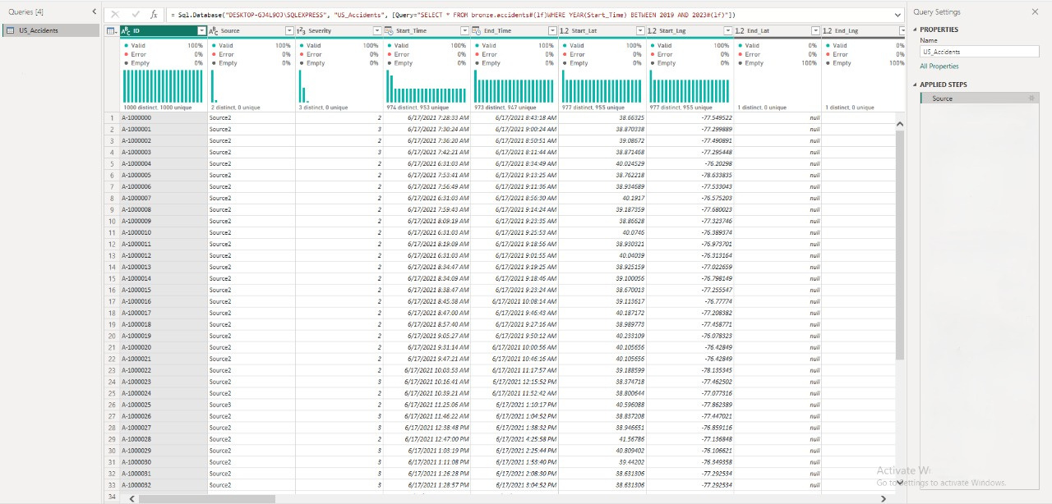

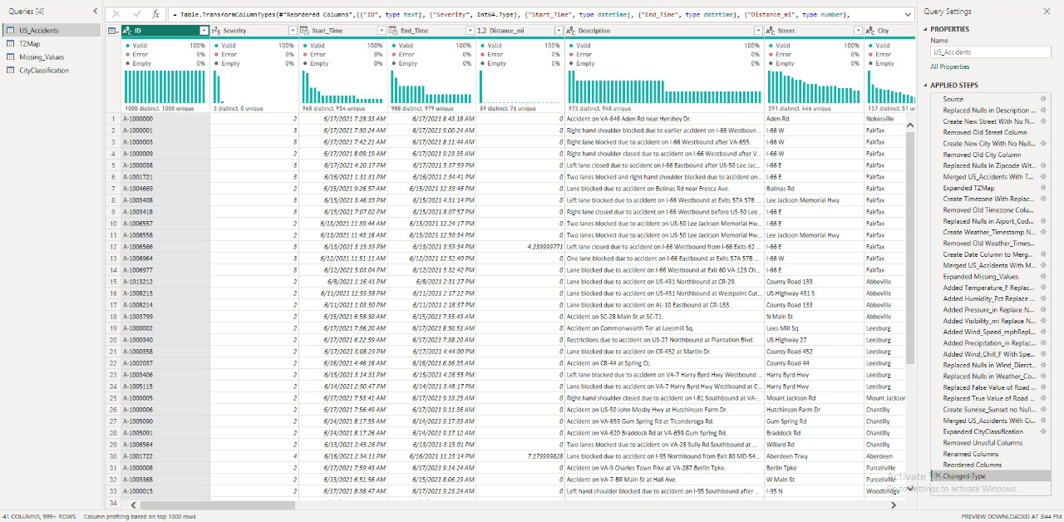
Before
After

Slide 13
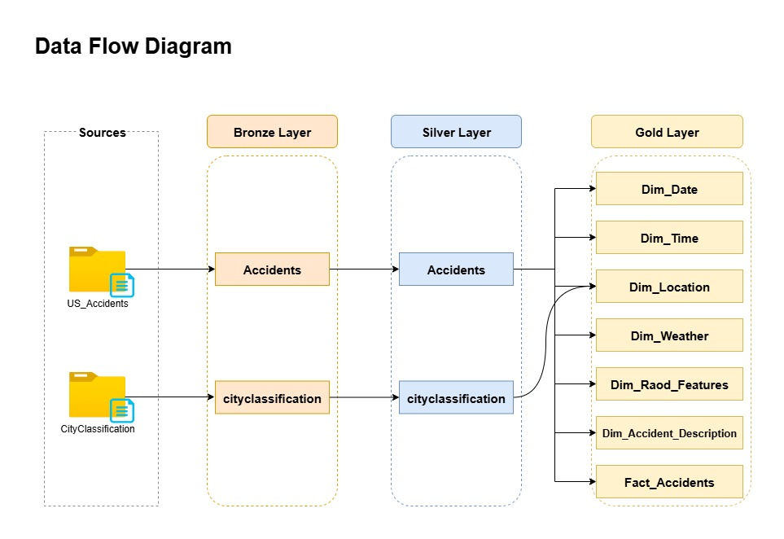
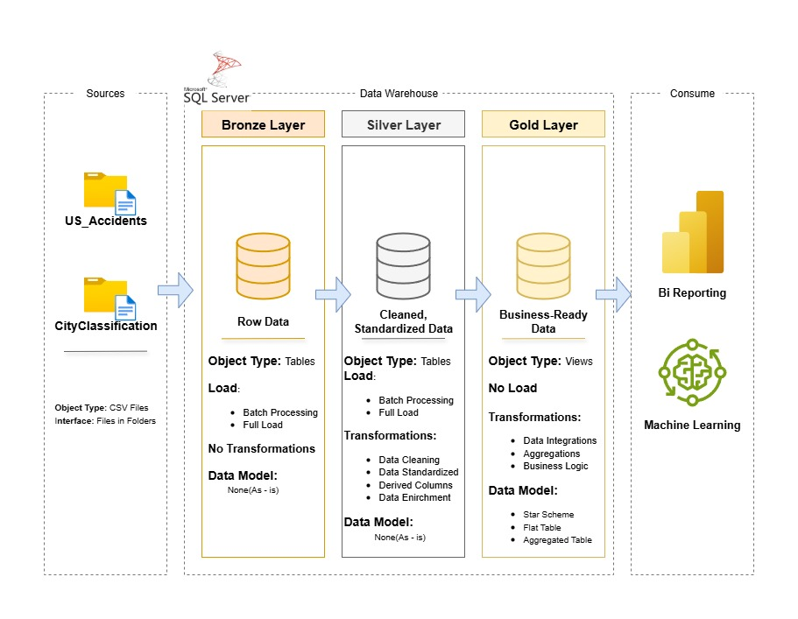
Data Cleaning
Using SQL

Slide 14
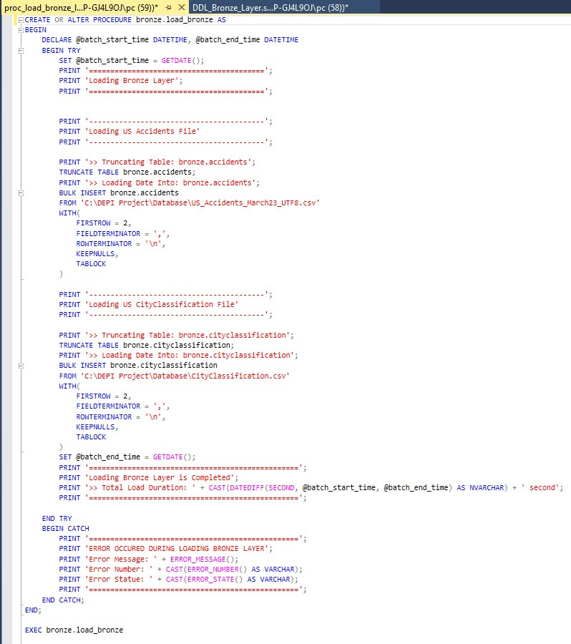
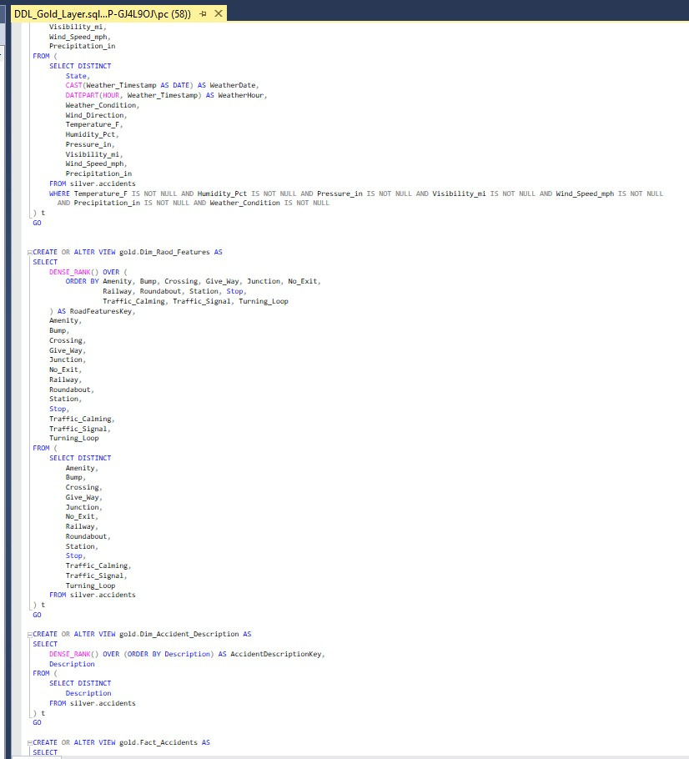
Data Cleaning
Using SQL

Slide 15
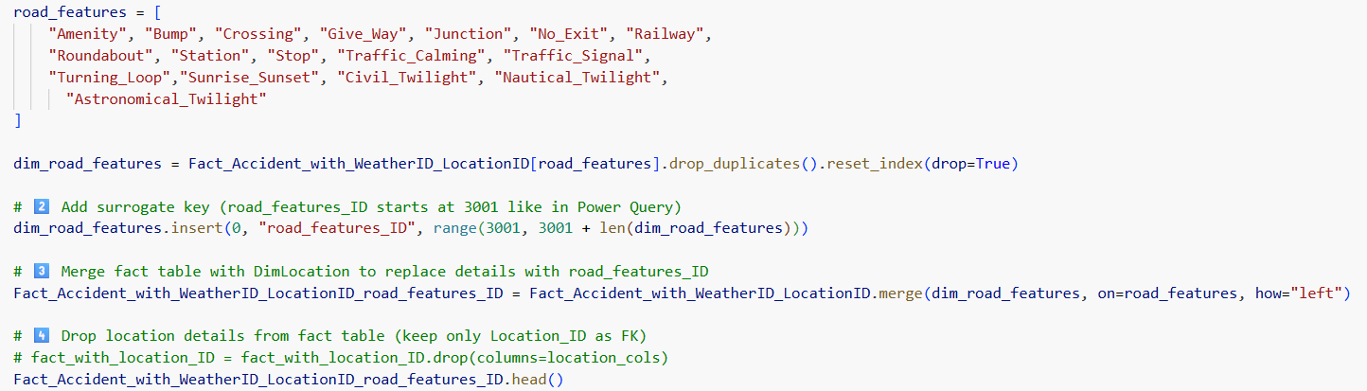
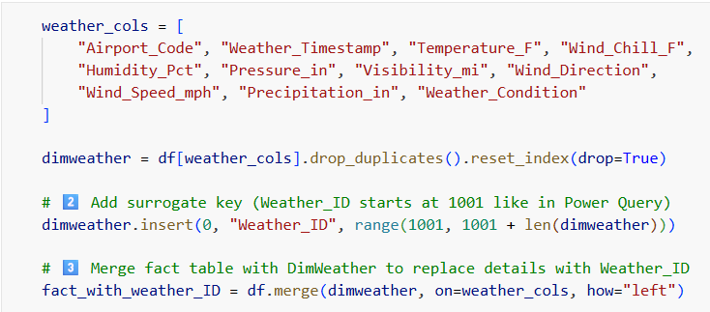
Data Cleaning
Using Python

Slide 16
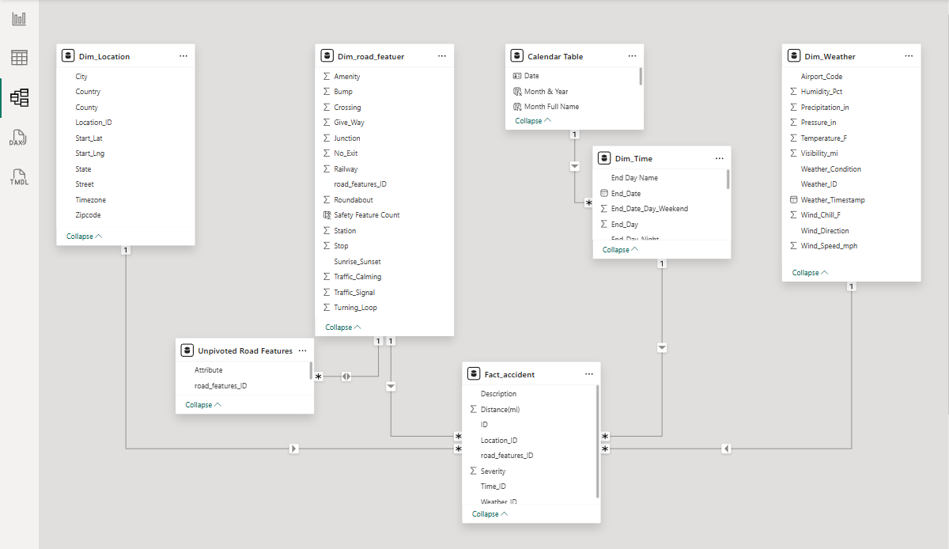
05 Data Modeling

Slide 17
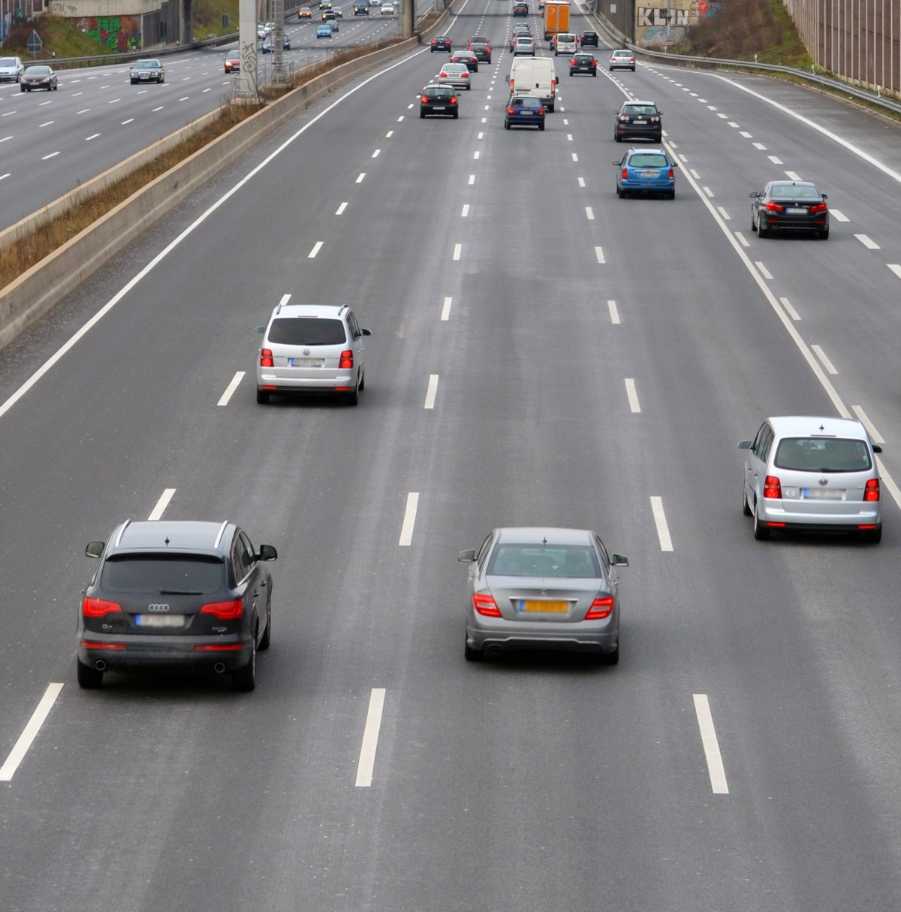

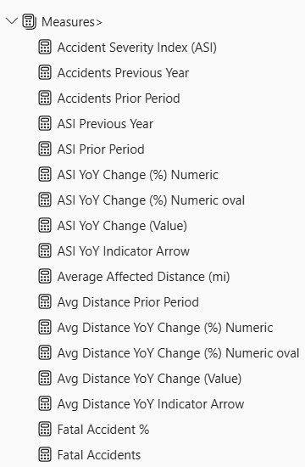
06 Dax
= Divide(
= Calculate(
= if(
= Average(

Slide 18
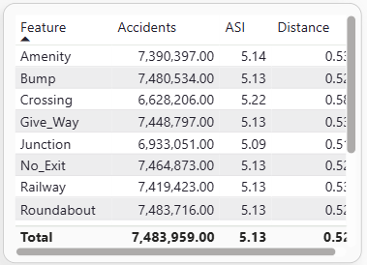
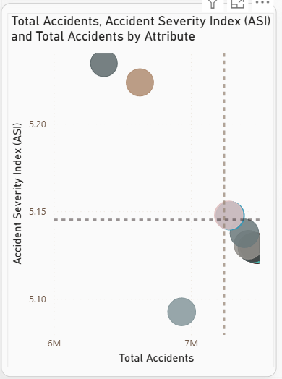
07 Sample Visuals
1) Table:
Showing the effect of different road features and distance on the number of accidents, and Accident Severity Index (ASI)
2) Bubble Chart:
Showing Total accidents, Accident Severity Index (ASI), and total accidents by road feature

Slide 19
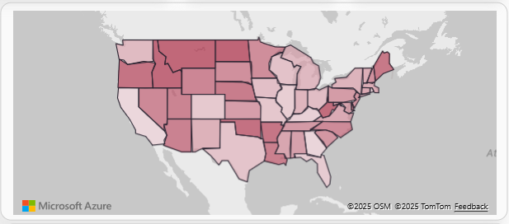
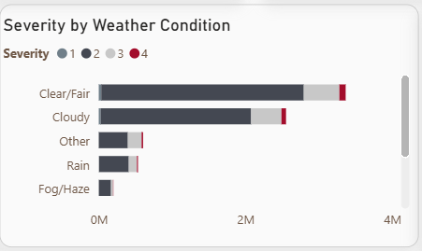
07 Sample Visuals
3) Map:
Showing number of accidents in each country
4) Bar Chart:
Showing Accidents Severity by different weather Conditions

Slide 20


9. Dashboard & Reports

Slide 21
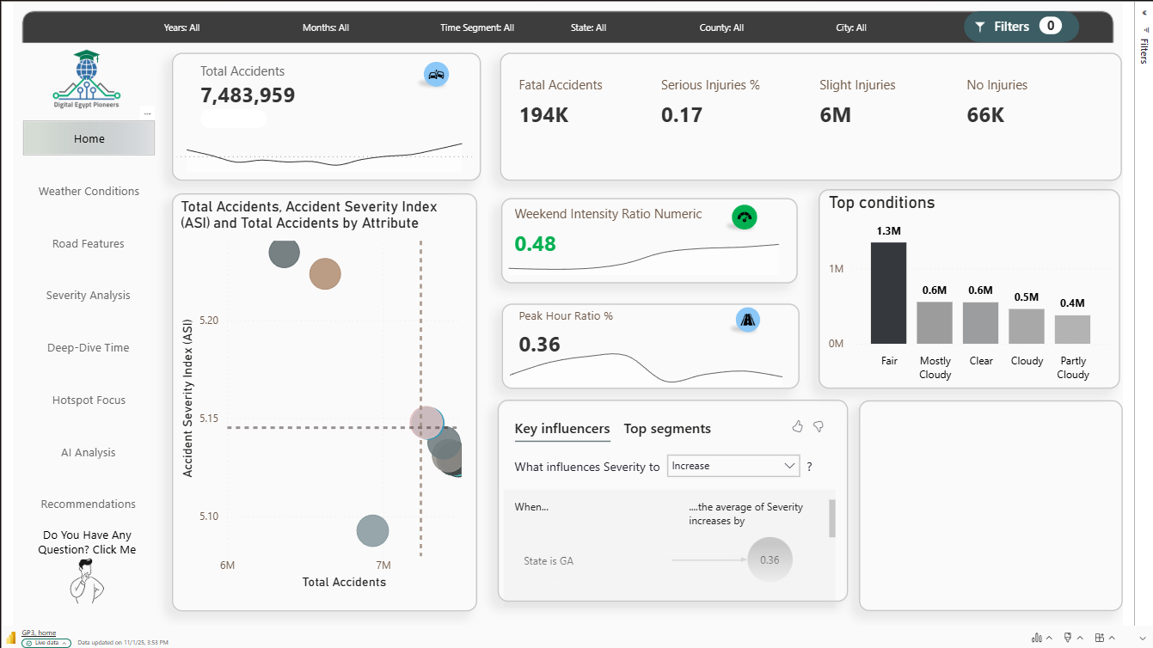
California (CA) has the highest number of Accidents
1.6M
Accidents
followed by Florida (FL) and Georgia (GA).

Slide 22
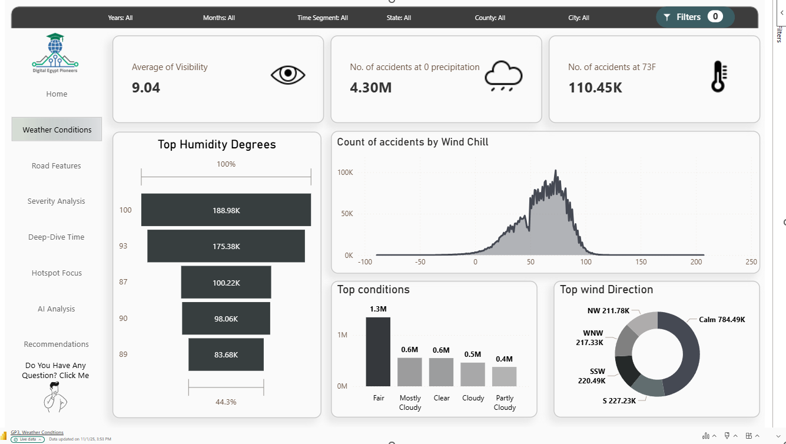
California (CA) has the highest number of Accidents
1.6M
Accidents
followed by Florida (FL) and Georgia (GA).

Slide 23
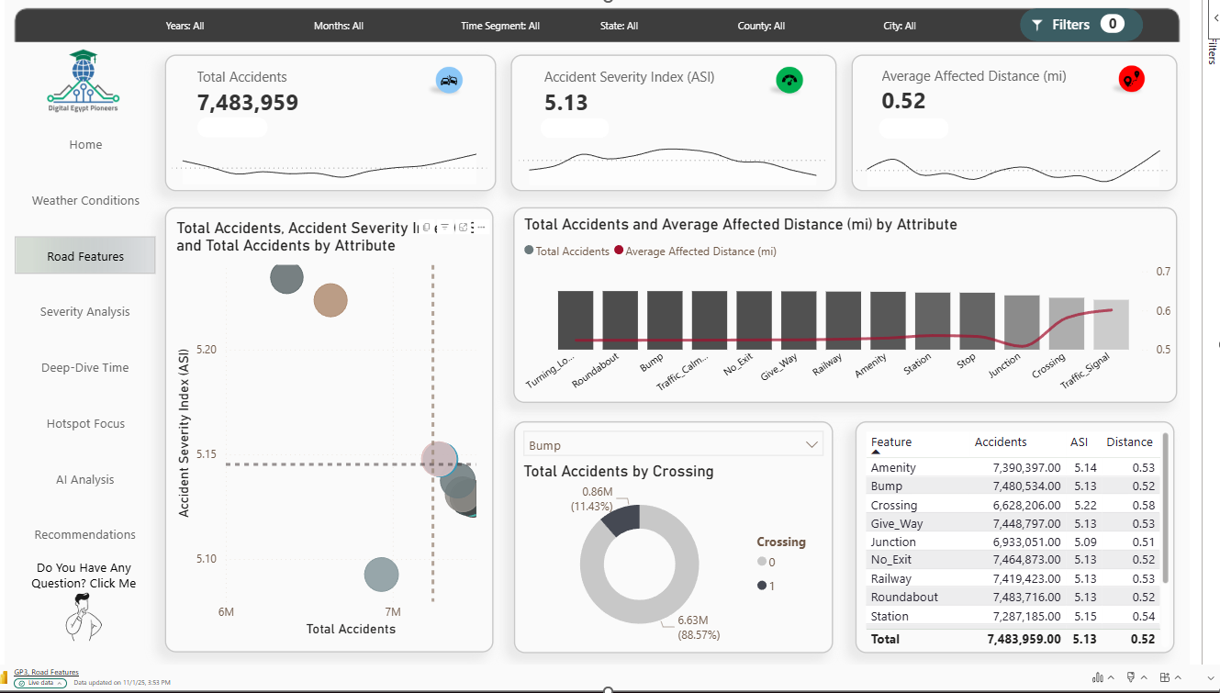
California (CA) has the highest number of Accidents
1.6M
Accidents
followed by Florida (FL) and Georgia (GA).

Slide 24
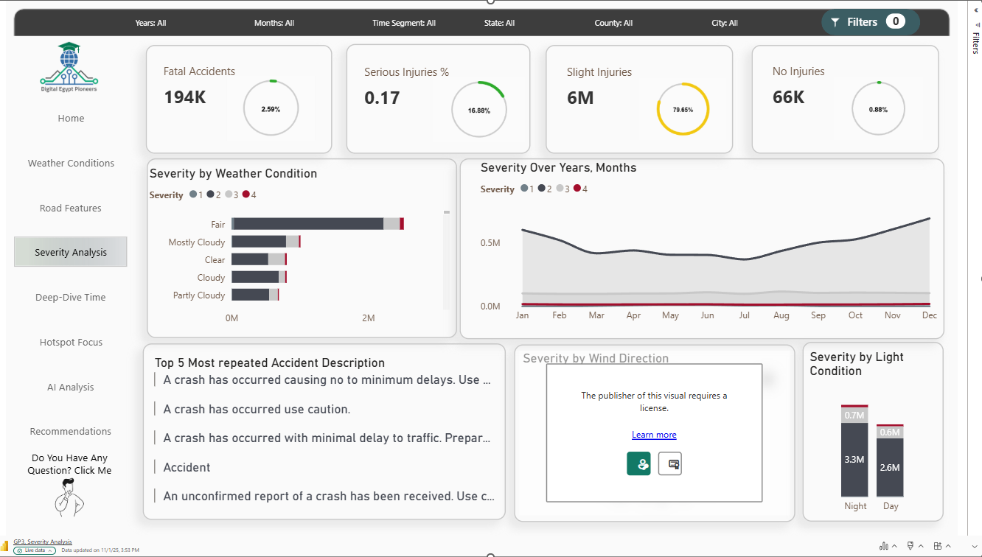
California (CA) has the highest number of Accidents
1.6M
Accidents
followed by Florida (FL) and Georgia (GA).

Slide 25
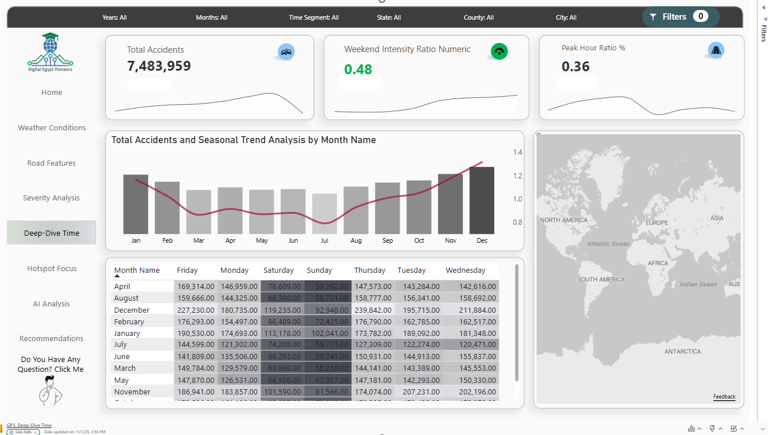
California (CA) has the highest number of Accidents
1.6M
Accidents
followed by Florida (FL) and Georgia (GA).

Slide 26
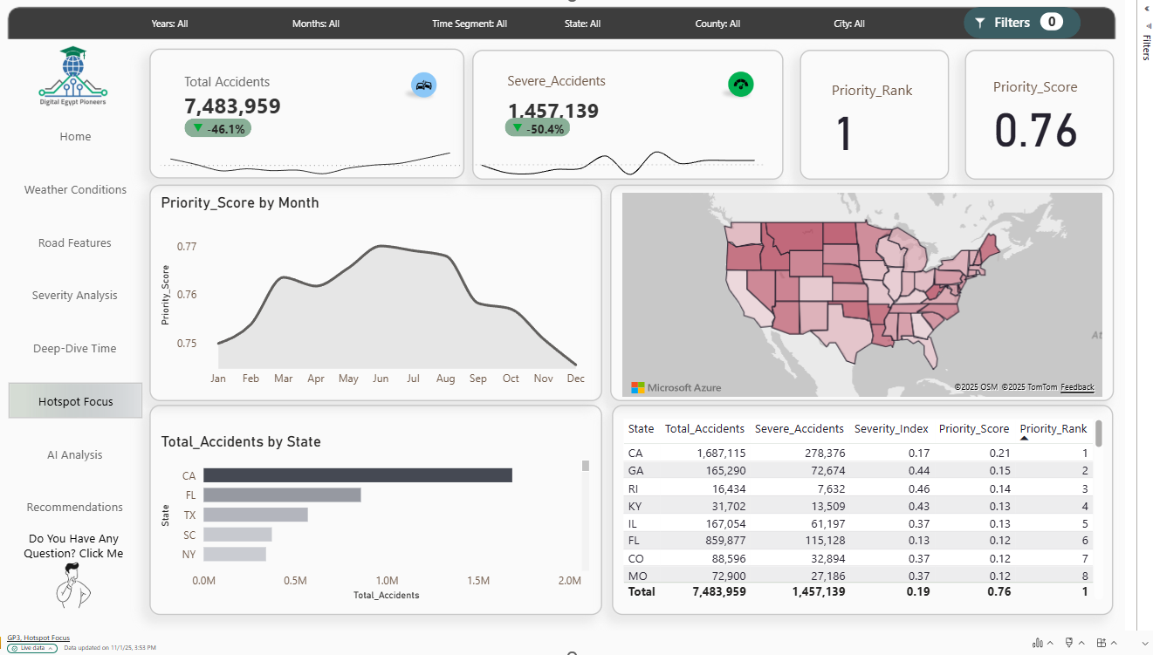
California (CA) has the highest number of Accidents
1.6M
Accidents
followed by Florida (FL) and Georgia (GA).

Slide 27
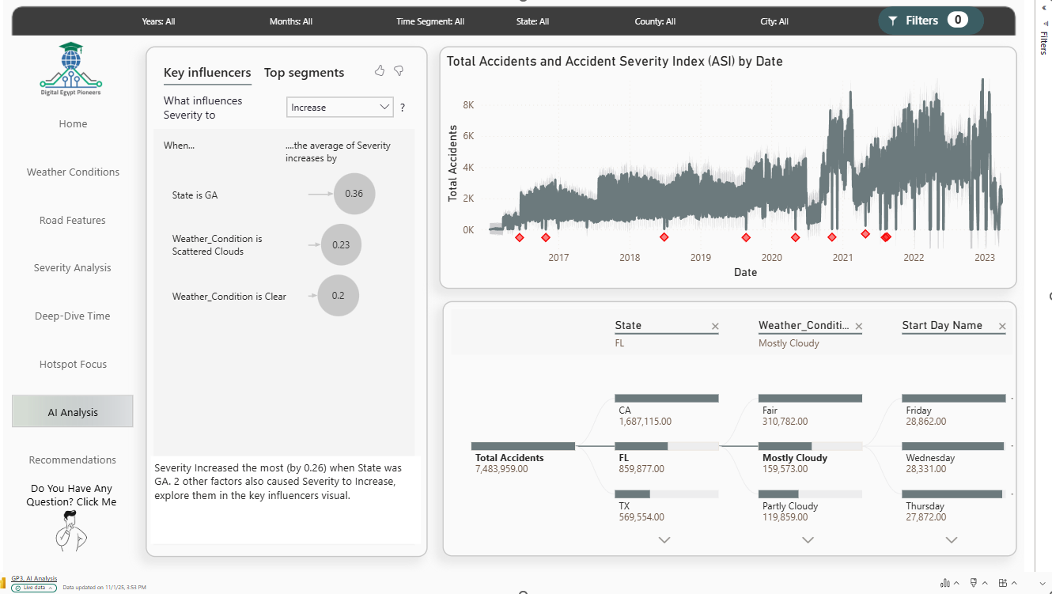
California (CA) has the highest number of Accidents
1.6M
Accidents
followed by Florida (FL) and Georgia (GA).

Slide 28
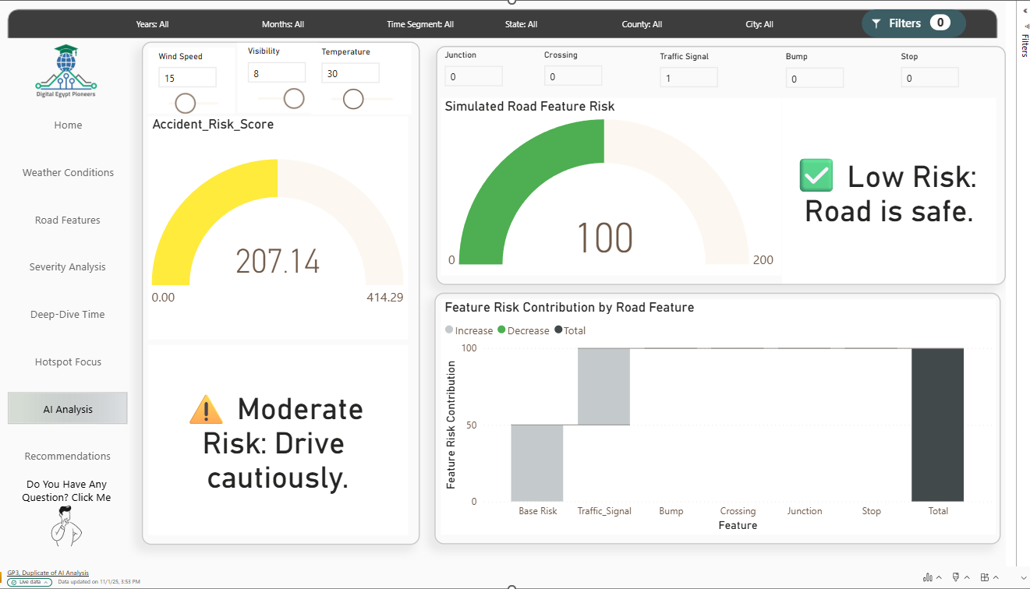
California (CA) has the highest number of Accidents
1.6M
Accidents
followed by Florida (FL) and Georgia (GA).

Slide 29
09 Key Results
California (CA) has the highest number of Accidents
Fair is the most common weather
1.6M
1.3M
Accidents
Accidents
followed by Florida (FL) and Georgia (GA).
Rain, Cloudy, and Clear conditions show higher severity.
Accidents Severity:
Road Features:
94.57%
7.3M
97.67%
2.58%
No Crossing
Accidents at Junctions
Slight Injuries
Fatal Injuries

Slide 30
09 Key Results
Accidents peak in December, January, and November
Tuesday has the highest number of accidents, especially in December.
3M
2M
Accidents during day
Accidents At Night

Slide 31




10 Recommendation
Focus on California
Prioritize Seasonal & Weekly Safety
Review Road Infrastructure
Allocate resources, awareness campaigns, and infrastructure reviews.
Increase alerts in December, January, November, and focus on Tuesdays.
Assess high-accident junctions and no-crossing areas to improve safety.

Slide 32

THANK YOU!

